Slide 1


MatchATT&CK
汇报人：徐屹

Slide 2

Content Page
01
02
03
Classification
Framwork
Rank Score
Usage
Search Engine
单项测试
多项测试
Security Rules
Mitre ATT&CK
Catalog

Slide 3
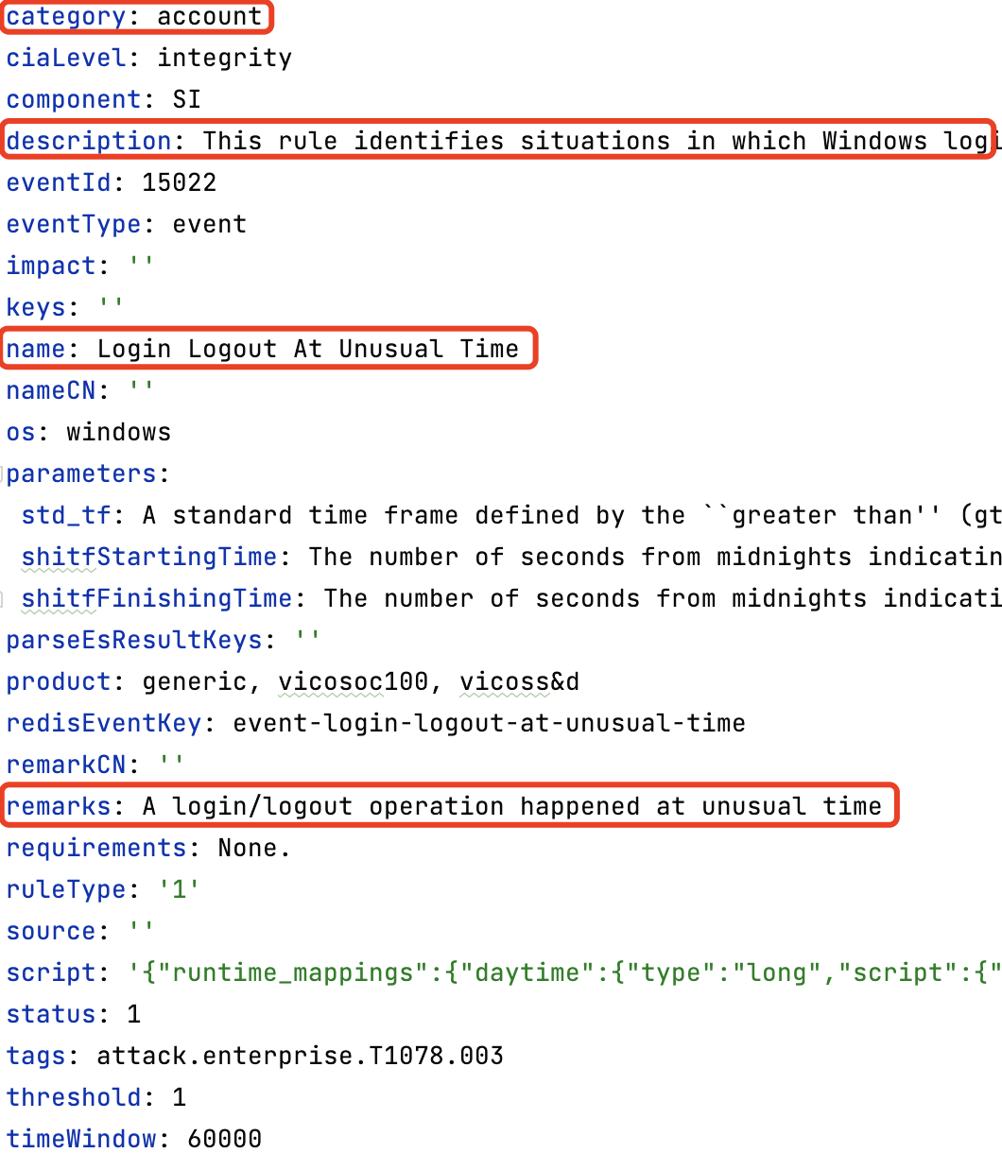
01
Classification Framework
Secutiy Rules
./tools/config.py 中定义使用到的字段
注：测试发现不使用 description 字段效果更好，相比于其它字段，description 字段带了更多的干扰信息，所以默认提取其它三个字段

Slide 4
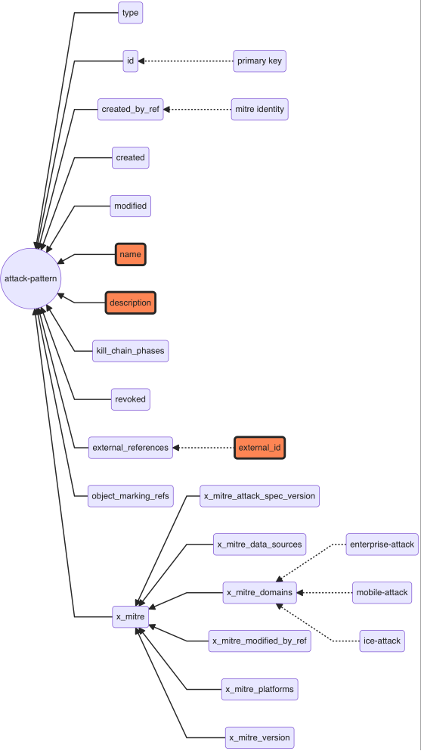
01
Classification Framework
Mitre ATT&CK
tools: stix2
ATT&CK 矩阵与实际数据 stix2中的对应概念
ATT&CK concept | STIX object type | Custom type?
Matrix | x-mitre-matrix | yes
Tactic | x-mitre-tactic | yes
Technique | attack-pattern | no
Sub-technique | attack-pattern where x_mitre_is_subtechnique = true | no
Procedure | relationship where relationship_type = "uses" and target_ref is an attack-pattern | no
Mitigation | course-of-action | no
Group | intrusion-set | no
Software | malware or tool | no
Data Source | x-mitre-data-source | yes
使用到的字段：
external_id
name
description
target
注：还有新增的两种 identity, marking-definition

Slide 5
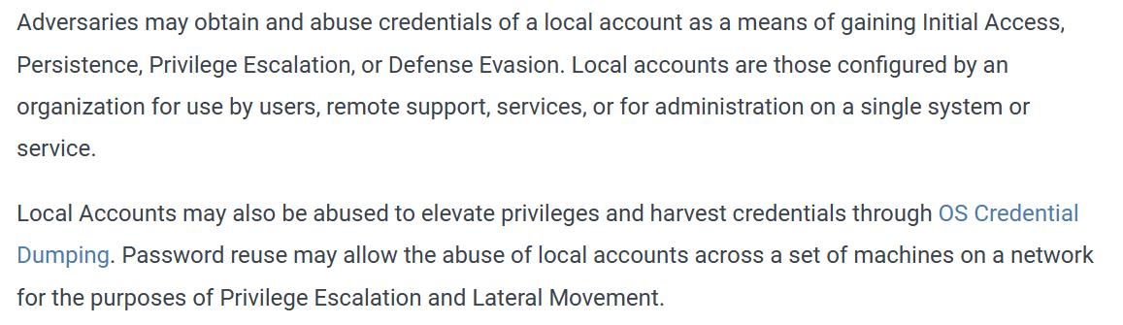


01
Classification Framework
Mitre ATT&CK
Q: 使用到的 name 和 description 字段与安全规则的描述完全不相关
T1078.003
Valid Accounts: Local Accounts
This rule identifies situations in which Windows login and logout operations are performed or attempted outside the normal working hours (e.g., whenever operators work in shifts, this rule can ensure that such login and logout operations happen in the supposed timeframe). As attackers can try to take advantage of the absence of personnel to exploit the target systems, rules like these one work on restricting the categories of security-related events happening at unexpected time.
15022
Login Logout At Unusual Time

Slide 6
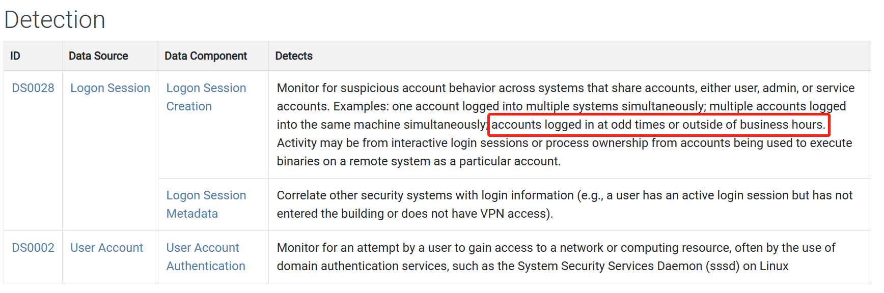

01
Classification Framework
Mitre ATT&CK
A: 发现数据来源中有相应描述，加入 DS
T1078.003
Valid Accounts: Local Accounts
This rule identifies situations in which Windows login and logout operations are performed or attempted outside the normal working hours (e.g., whenever operators work in shifts, this rule can ensure that such login and logout operations happen in the supposed timeframe). As attackers can try to take advantage of the absence of personnel to exploit the target systems, rules like these one work on restricting the categories of security-related events happening at unexpected time.
15022
Login Logout At Unusual Time

Slide 7



01
Classification Framework
Mitre ATT&CK
重构攻击手段的组成
Property | Role in Framework | Function
id | technique id (Txxxx) | targer output, primary key
name | name of technique | match keywords
description | description of technique | match keywords
detects | data sources | match keywords
预处理 clean_data.py transform.py
分词，去除标点符号和停用词
01
词性还原，
词性标注后提取名词
02
词元化——提取词干
(3种算法)
03

Slide 8
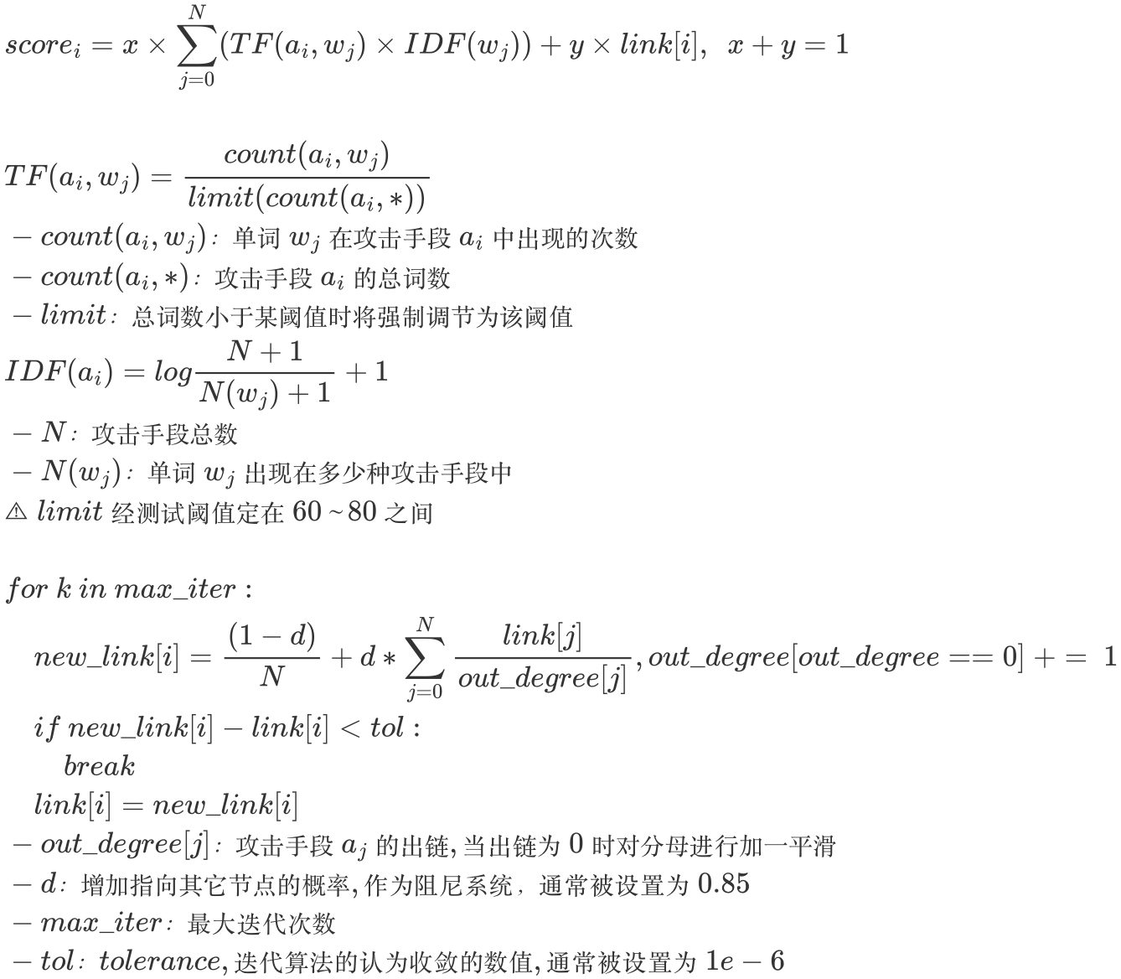
02
Rank Score
综合评分
TF-IDF score + PageRank score

Slide 9

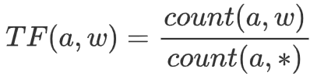
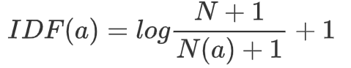
02
Rank Score
TF-IDF
单词的重要性/信息量
一个单词在文中出现的频率很高 关键词
一个单词在文中出现的频率很低 不是关键词
单词w在攻击手段a中出现的频率
核心思想
TF
词频
IDF
逆文档
频率
如果一个单词在很多的文档中出现，则意味着该单词的的重要性不高；反之则意味着该单词的重要性很高。
×
count(a, w)：单词w在攻击手段a中出现的次数
count(a, *)：攻击手段a的总词数
N：攻击手段总数
N(a)：单词w出现在多少种攻击手段中

Slide 10
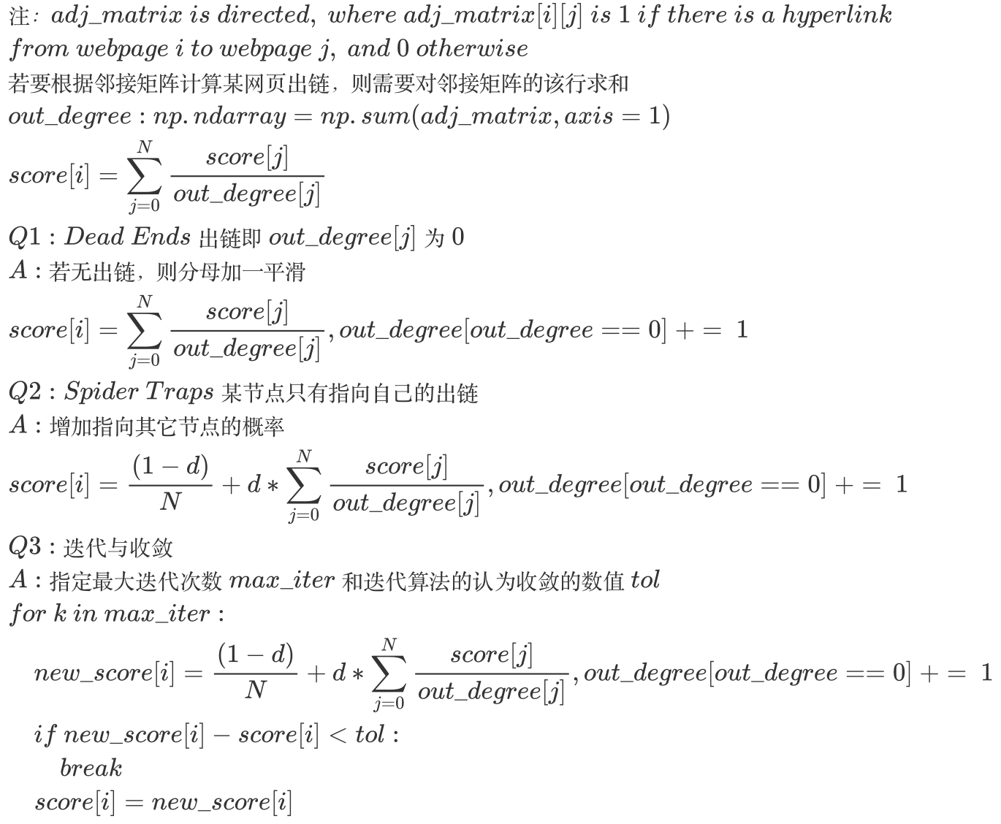
02
Rank Score
PageRank
增加外链权重

Slide 11
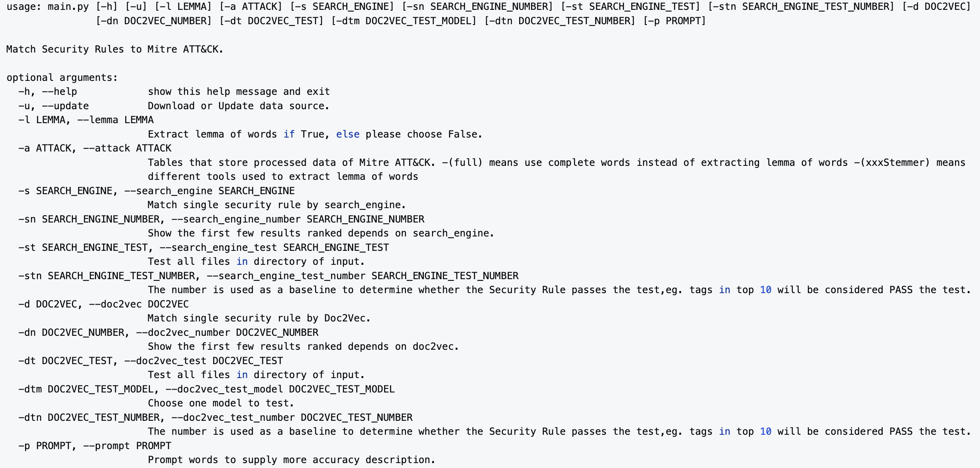
03
Usage
-h

Slide 12
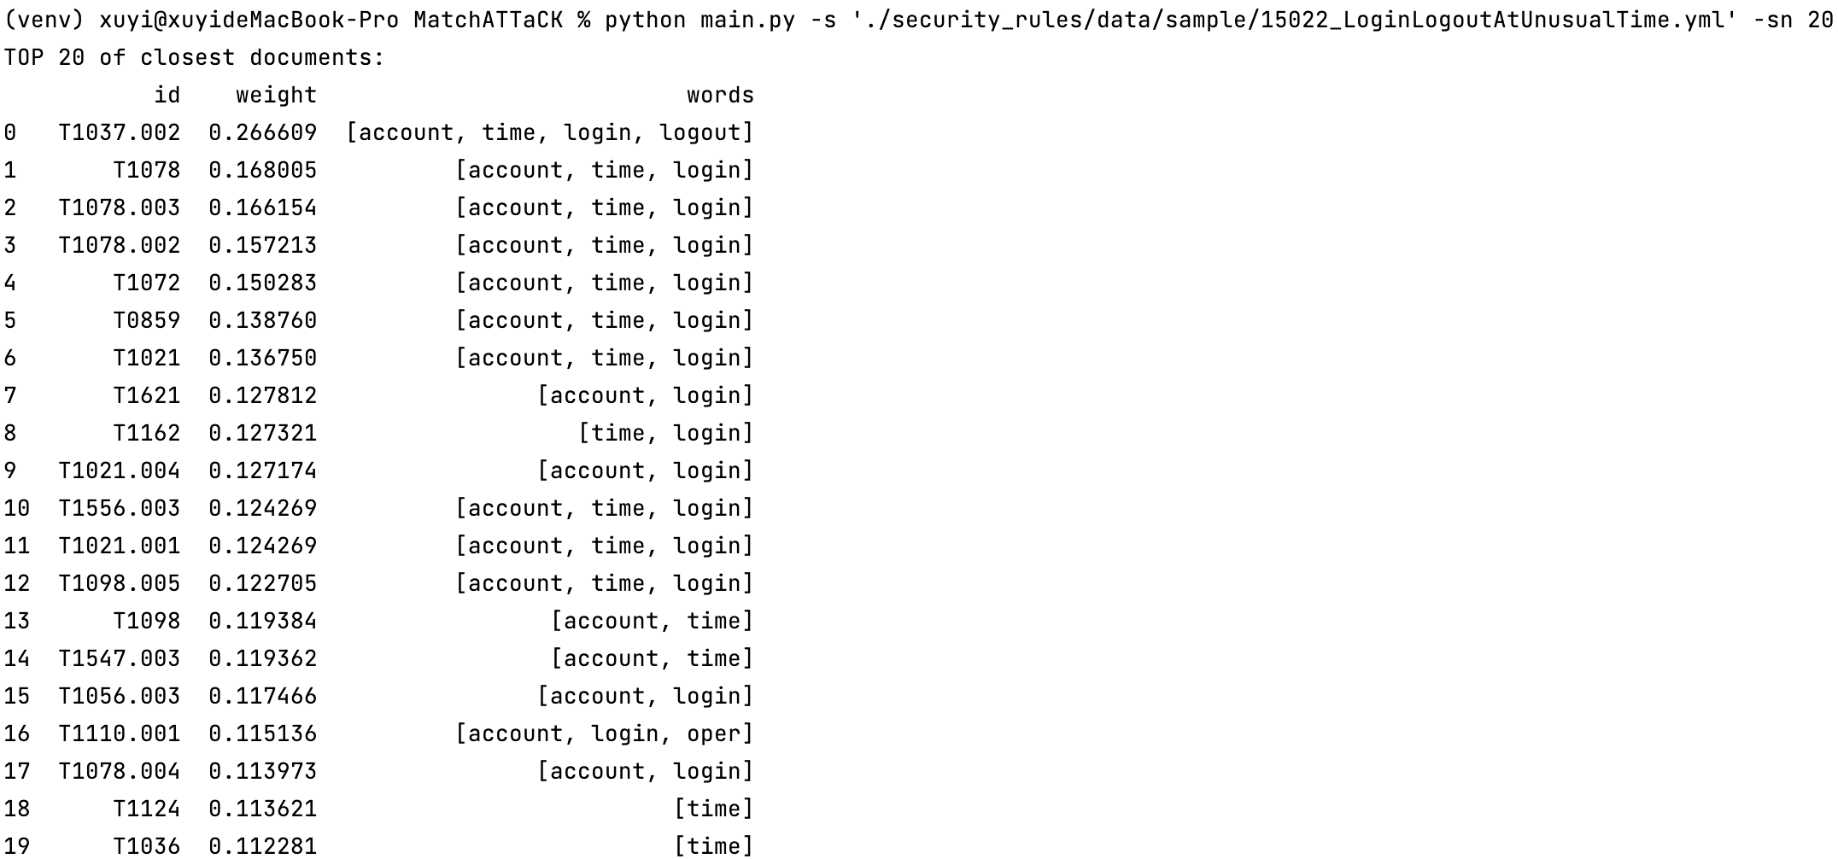
03
Usage
单项测试
-s 单项测试文件路径 -sn 排位最高的前几项

Slide 13
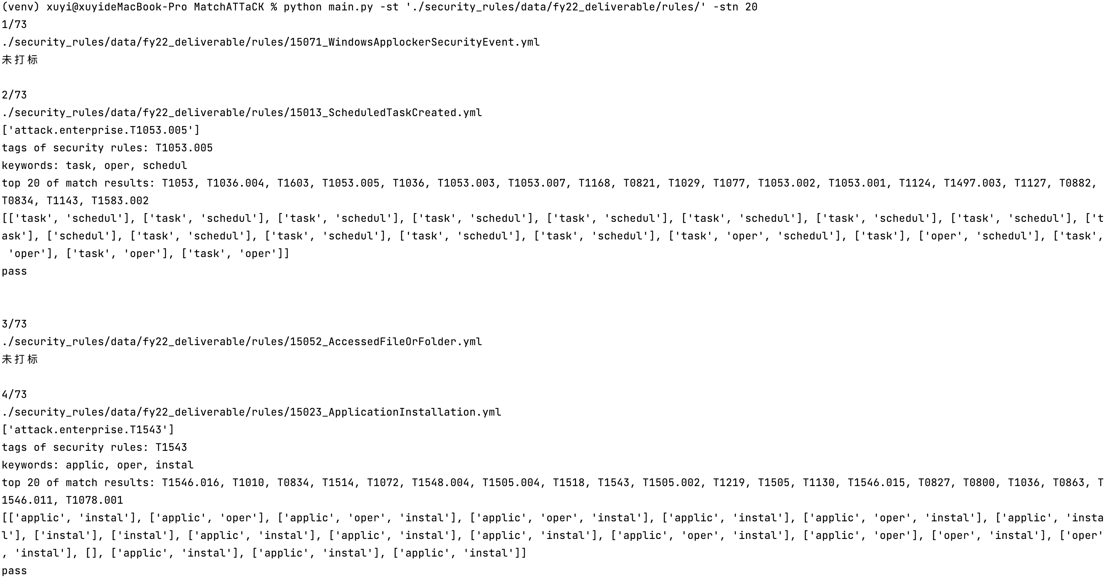
03
Usage
多项测试
-st 多项测试目录路径 -stn 排位最高的前几项

Slide 14
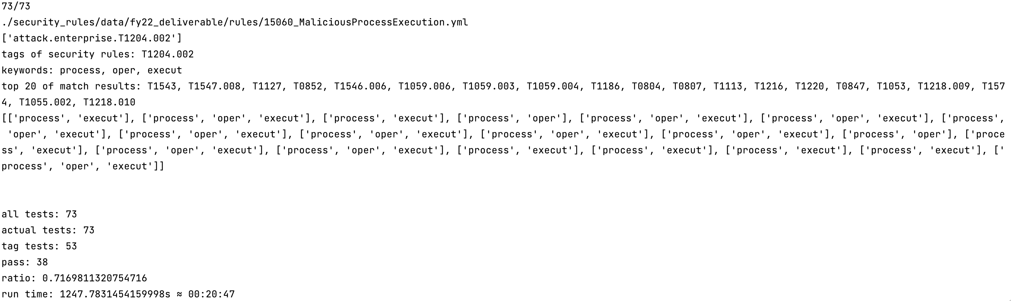
03
Usage
多项测试
结果统计

Slide 15

THANKS
汇报人：徐屹

